Slide 1


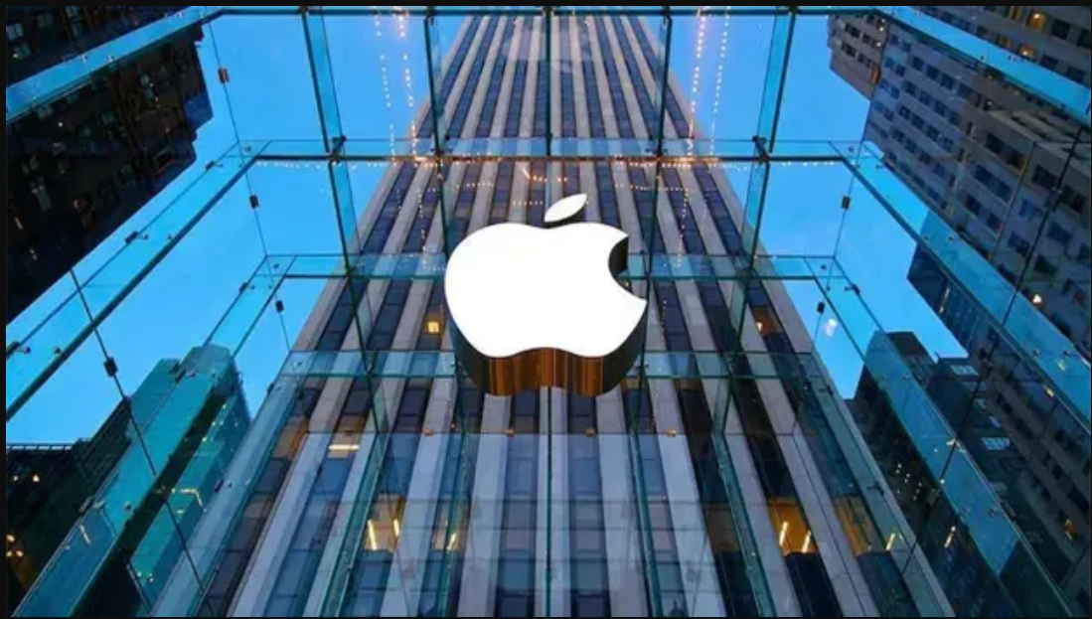





Apple
Company
Created By:
Revan Saman
Sara Sami
Supervisor:
Mr.Bishwan Kamaran

Slide 2
01
02
Table of contents
03
04
About Apple
The importance of the company
Company damages
Some points

Slide 3
About company
01
Apple Inc. was founded on April 1, 1976, in Cupertino, California, by Steve Jobs, Steve Wozniak, and Ronald Wayne. Initially focused on personal computers, the company grew into a global tech leader, known for innovations like the iPhone, Mac, and iPad.

Slide 4

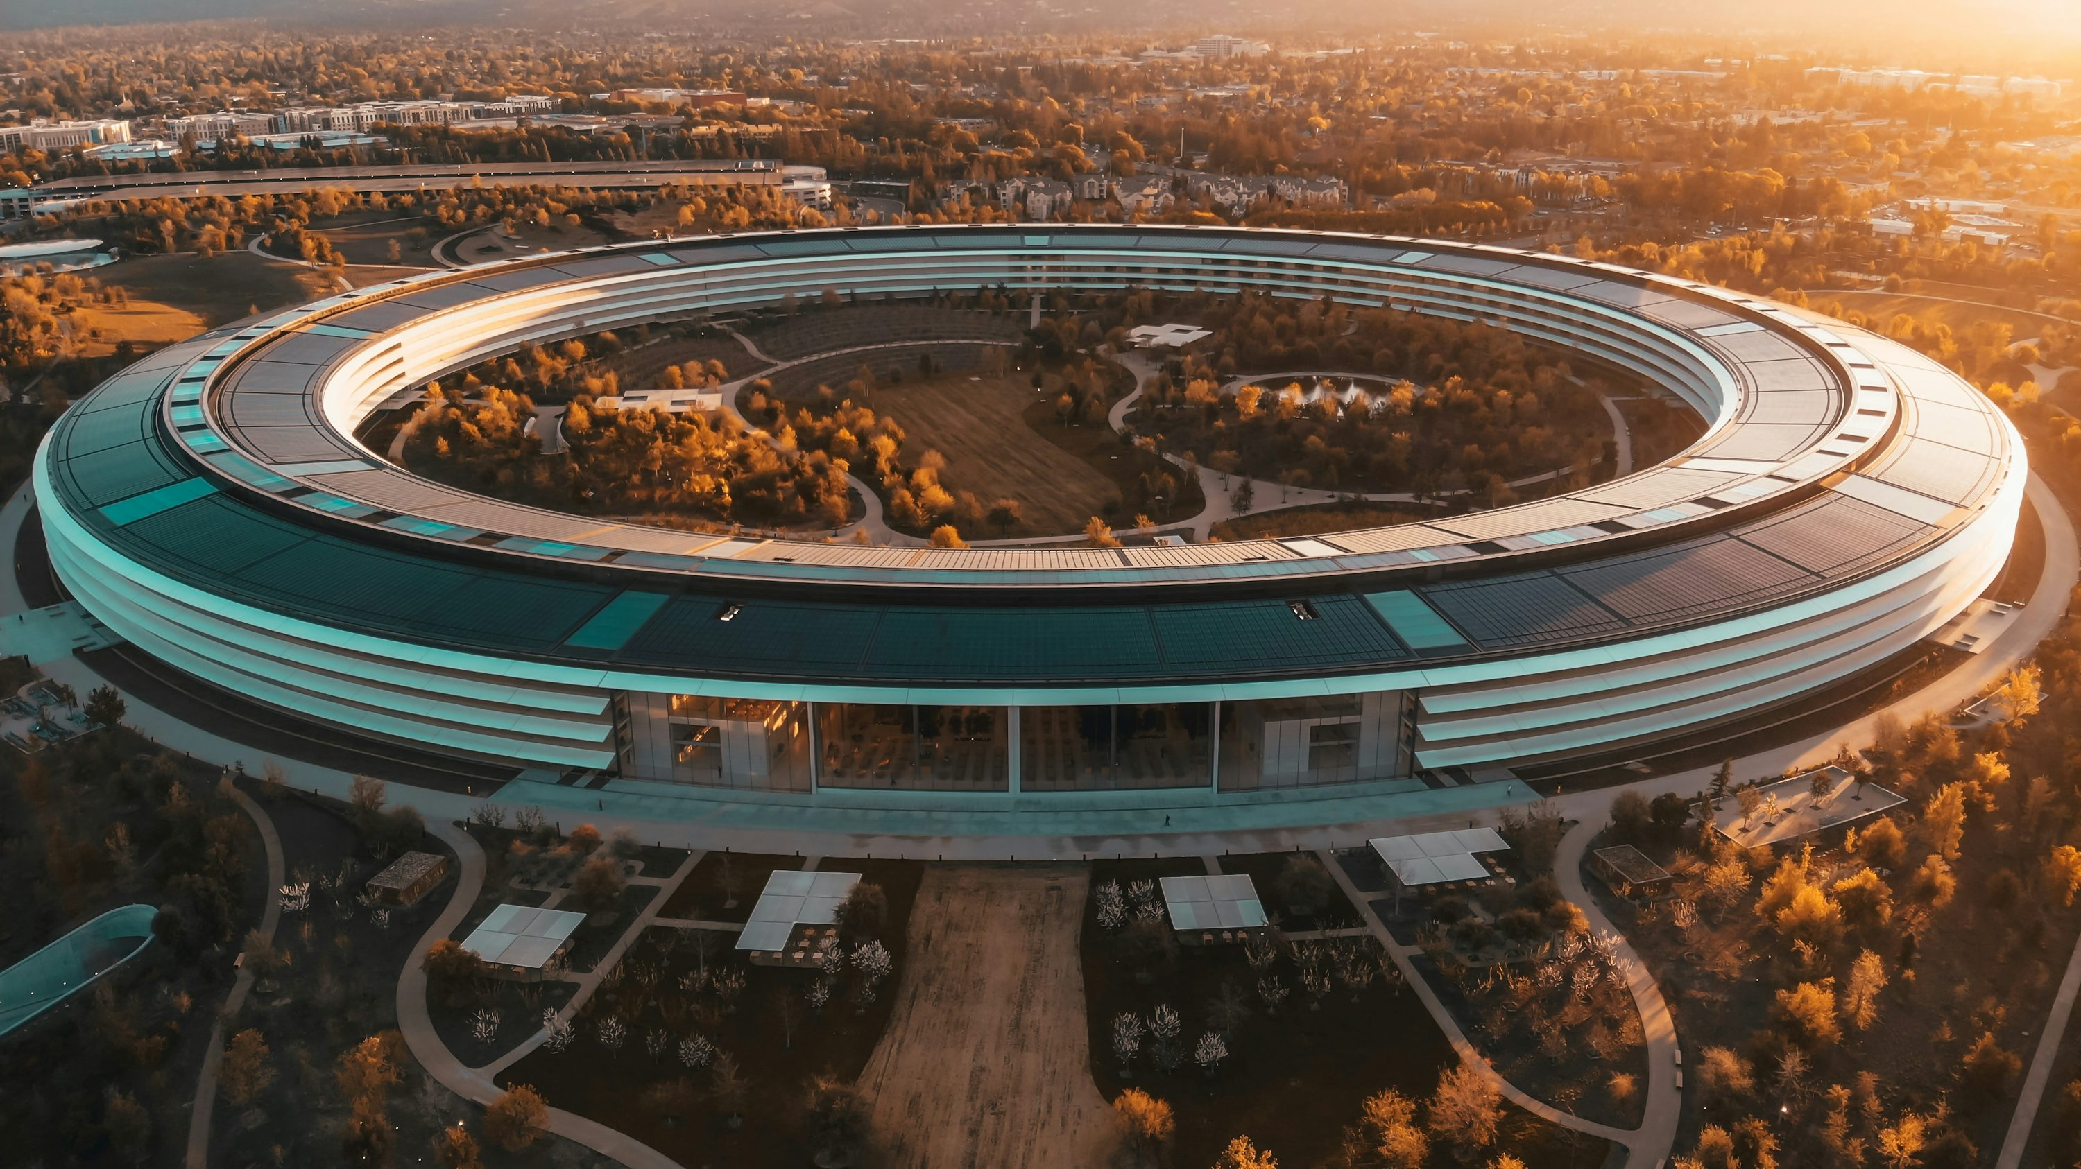
The importance of the company
02

Slide 5
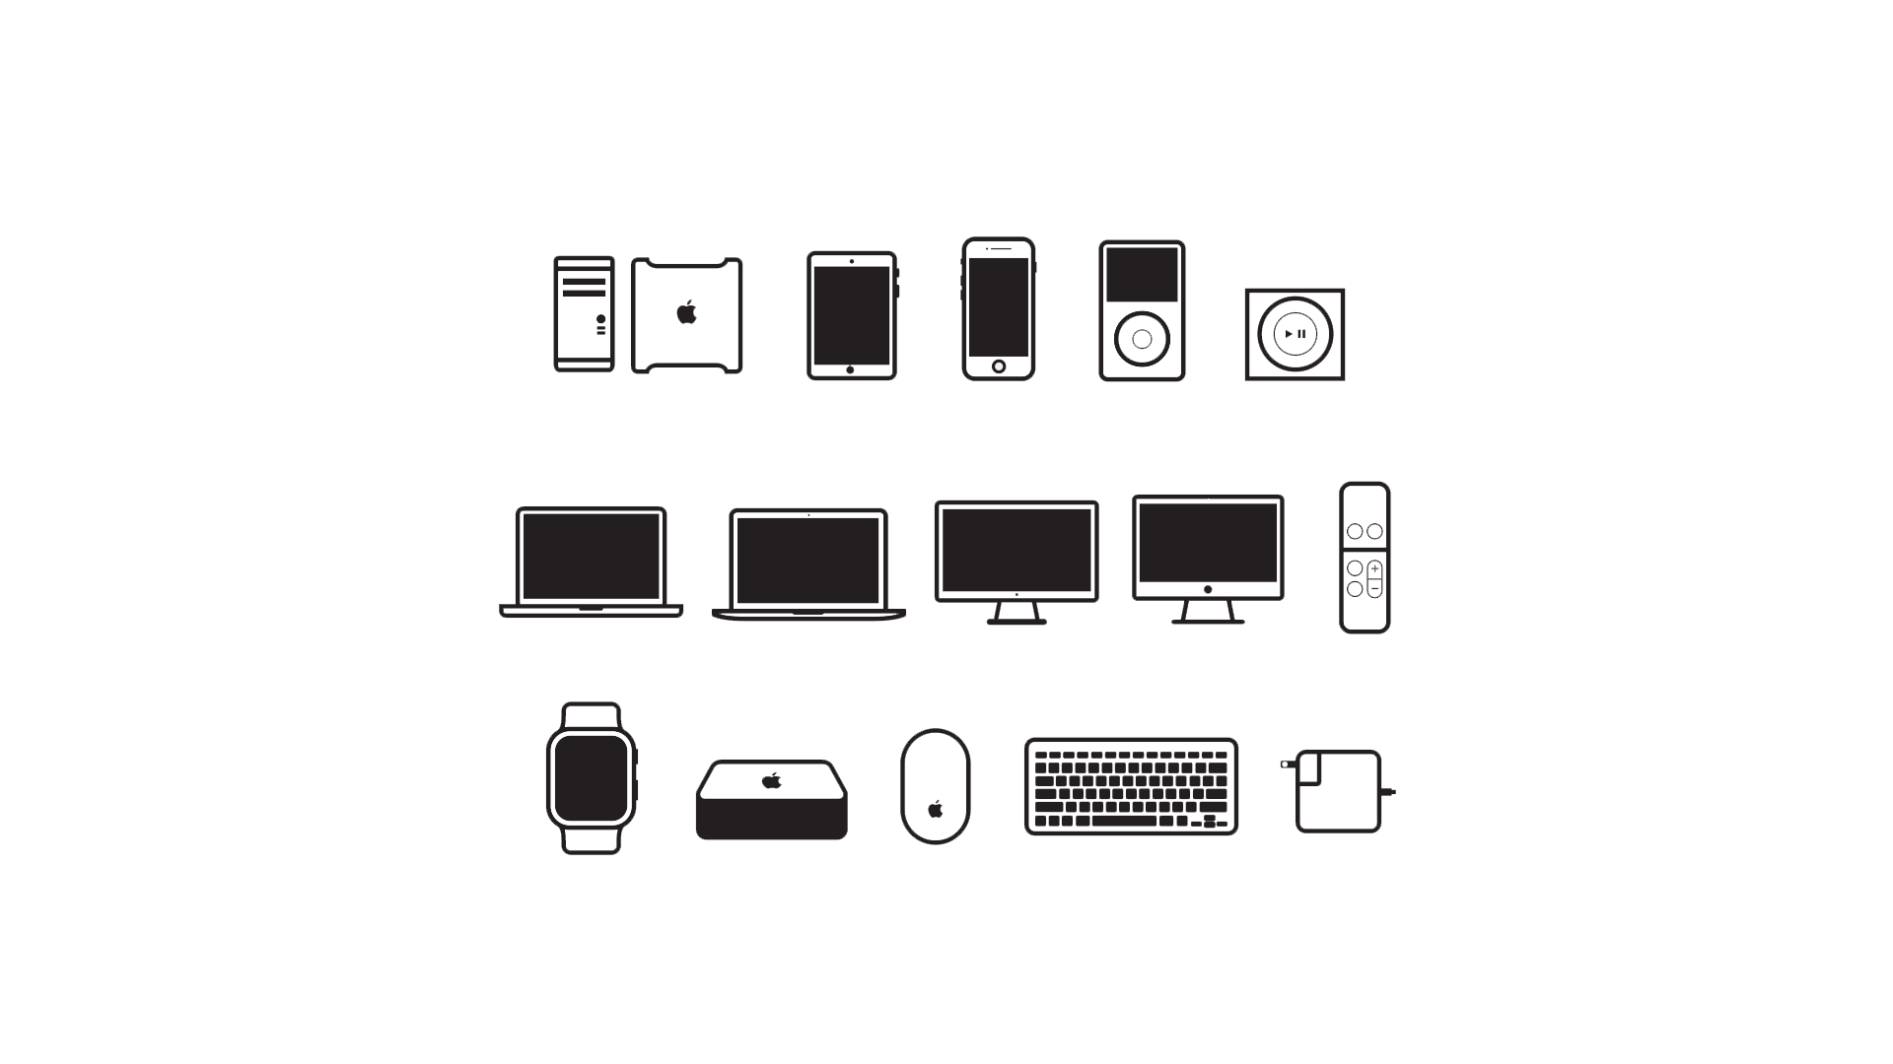

Company importance
Global Economic Impact
Ecosystem Integration
Innovation in Technology
Increase
Decrease
Jobs
Unemployment

Slide 6

Company damages
03

Slide 7


Company damages
E-Waste Contribution
High Pricing

Slide 8

04
Some Points

Slide 9


Some Points
Design Excellence
Brand Loyalty
Apple is renowned for its sleek and user-friendly designs, blending aesthetics with functionality. Its focus on minimalism and intuitive interfaces has set a benchmark for product design worldwide.
Apple has cultivated a devoted customer base through quality products and consistent innovation. This loyalty has turned its launches into global events, driving both sales and cultural influence.

Slide 10
Thanks!
DO YOU HAVE ANY QUESTIONS?

